Slide 1
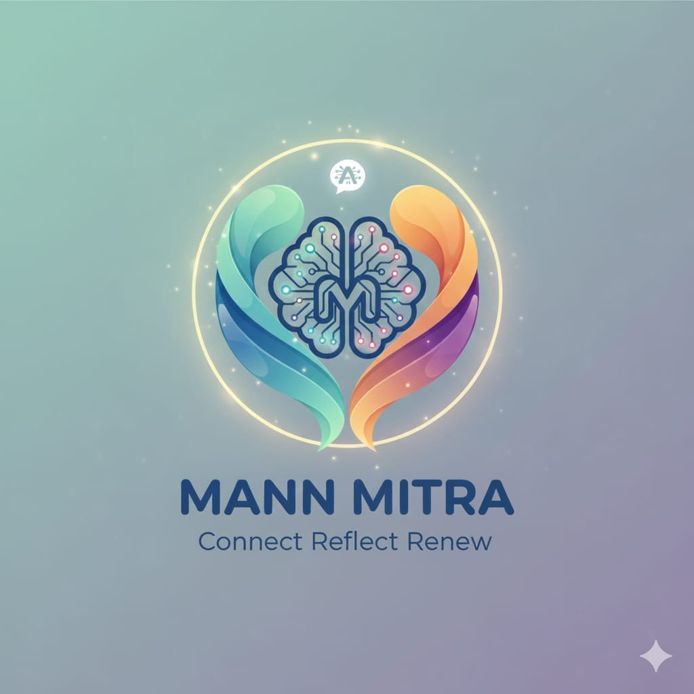
MANN MITRA
A Generative AI-Powered Health Tech Solution for Student Wellness & Productivity.
GenAI Hackathon-Lucknow
Mann Mitra is an innovative health tech companion leveraging Generative AI to empower student mental well-being and academic productivity. It offers personalized online and offline tools to address mental health challenges and enhance success.
Team - Mindsparks
Nitin Singh (Team Leader)
Prastuti Srivastava
Shivam Mishra

Slide 2



The Challenge: Students in Crisis
Rising Mental Health Crisis
Student stress, anxiety, and burnout have reached alarming levels, with inadequate support systems.
Accessibility Gap
Rural and low-connectivity students lack access to premium mental health apps and professional support.
Stigma Barrier
Fear of judgment prevents students from seeking help through traditional, public-facing channels.
Fragmented Solutions
No single platform combines AI-powered support with offline functionality for truly universal access.

Slide 3
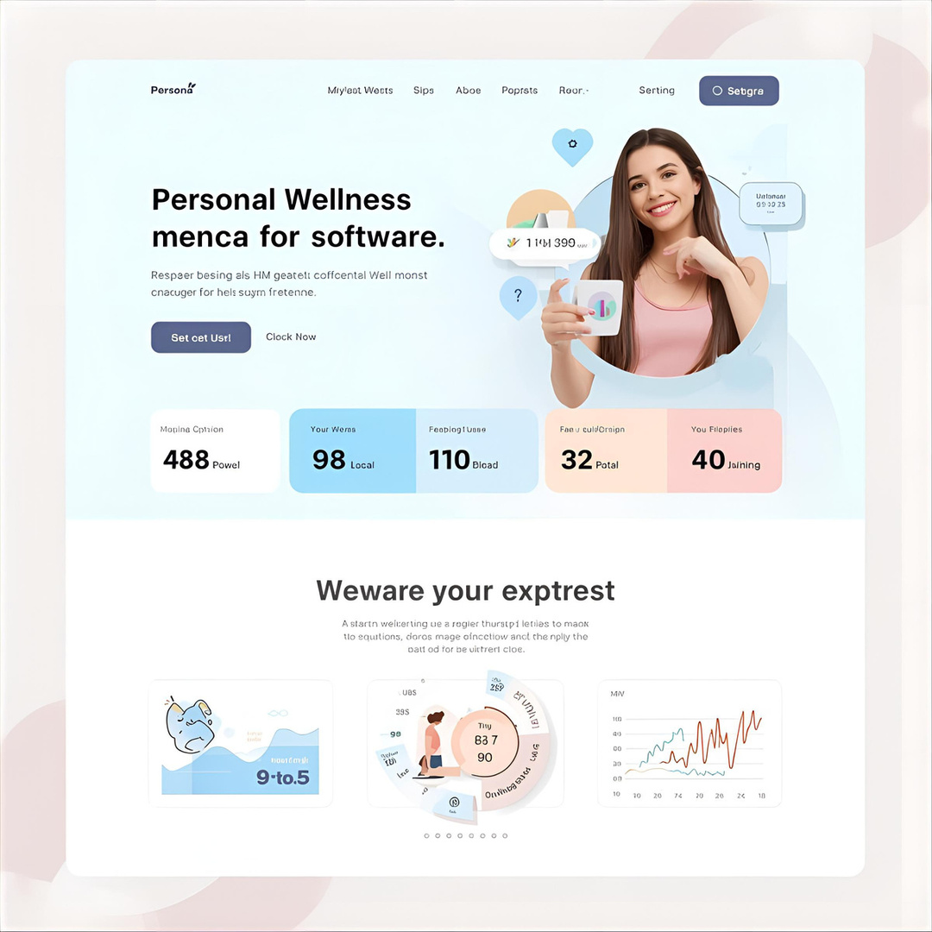
Meet Mann Mitra: Your Personal Wellness Companion
Always There. Always Accessible.
Mann Mitra is an empathetic AI companion designed specifically for students. Chat with an intelligent mentor who understands your challenges, track your emotional and academic progress, and access wellness tools anytime—even without internet.
Manage stress, stay focused, grow stronger—together.

Slide 4






Dual-Powered: AI + Offline Excellence
Smart Mood Analyzer
Conversational Mentor
Intelligent emotion detection from daily reflections
Empathetic AI support in English & Hindi
Habit Tracker
Guided Meditation
Study and wellness monitoring—works offline
Meditation, breathing, and focus tools preloaded
Create Affirmations
Multilingual Support
Good Affirmations
Native AI conversations in multiple languages

Slide 5





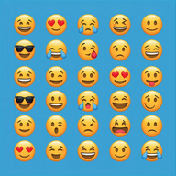
Generative AI Magic: Personalization at Scale
Guided Meditation
Transforms your mood logs into meaningful reflections and insights about your emotional patterns.
Affirmation
Creates personalized affirmations and focus strategies tailored to your unique challenges and goals.
Context-Aware Chat
AI learns your communication style, emotional tone, and preferences from every conversation.
Adaptive Plans
Generates customized study schedules and wellness goals that evolve with your needs.
Emotional Translation
Ensures multilingual support preserves nuance and empathy across languages.

Slide 6





Offline-First Design: No Student Left Behind
Works Anywhere. Syncs Everywhere.
Guided Exercises — Breathing and focus activities built-in
Wellness Articles — Tips and guidance in Hindi & English
Study Tracking — Monitor habits offline, visualize progress later

Slide 7







TECHNICAL APPROACH
Layer
Technology
Why It Works
Frontend
Streamlit / FlutterFlow
Rapid UI without coding complexity
Backend
Authentication, database, hosting in one platform
Ollama API
AI Engine
OpenAI / Gemini API
Generative power without training models
Mood Detection
Ollama3.8 API
Lightweight inference via API calls
Security
HTTPS
Enterprise-grade protection built-in
Zero heavy model training. All APIs cloud-based. Local caching handles offline scenarios seamlessly.

Slide 8


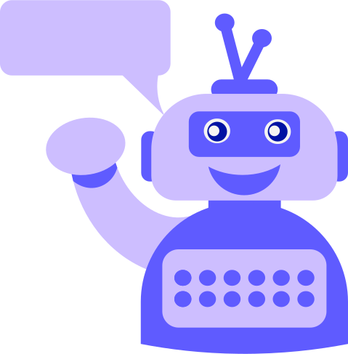
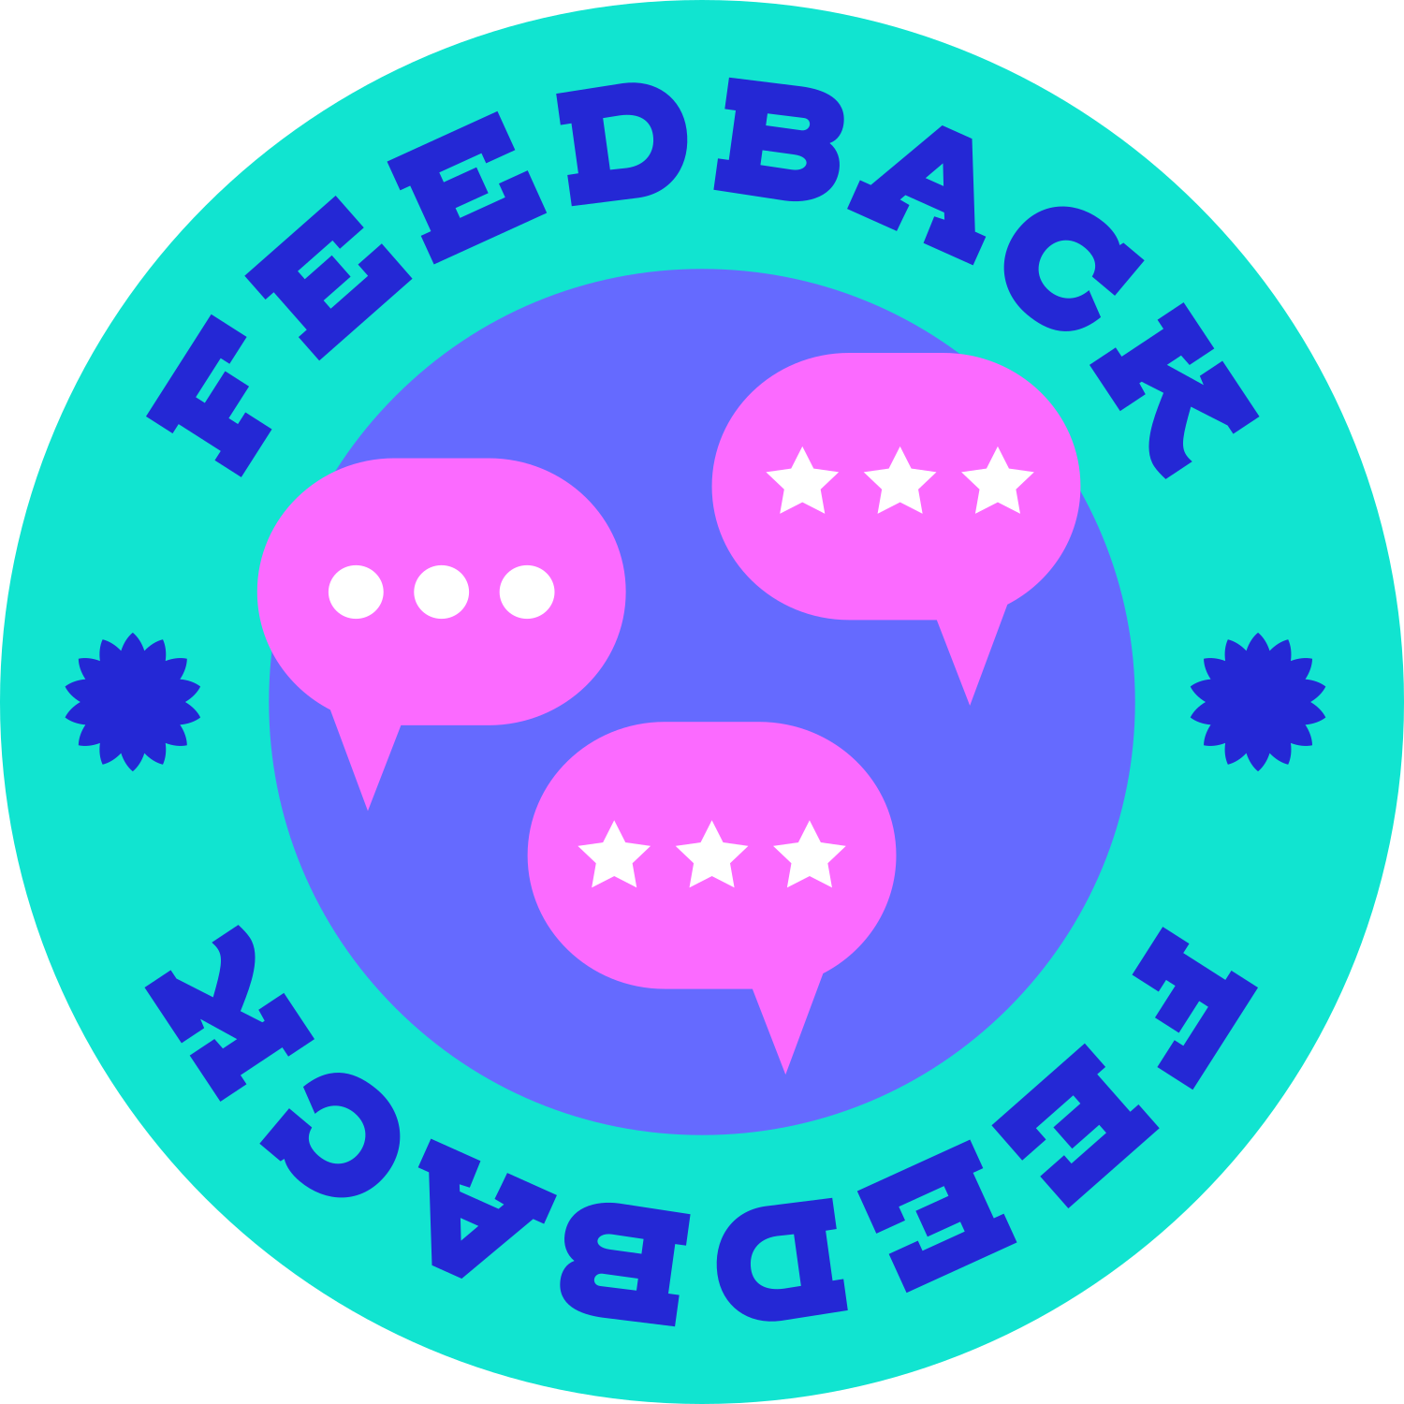

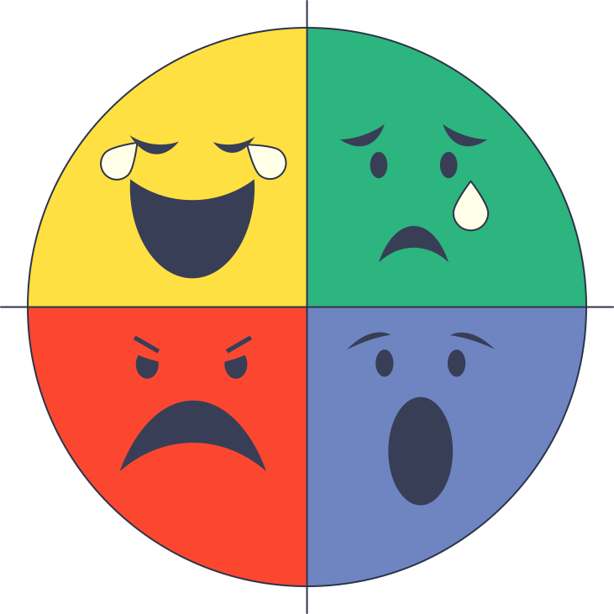


Our ChatBot Offer these Features
User
Students start with personalized login or instant offline access via guest mode.
Choose Your Path
Chatbot Interaction
Select AI Chat for support or wellness tools.
Feedback
Log Your Mood
Share how you're feeling — receive AI reflections or local wellness tips instantly.
Get Your Plan
Emotion Analyser
Receive a personalized 3-day micro-plan for studying and emotional wellness.
Progress Tracker
Track & Grow
Monitor daily progress with visual charts showing emotional and academic trends.
Recommendation

Slide 9



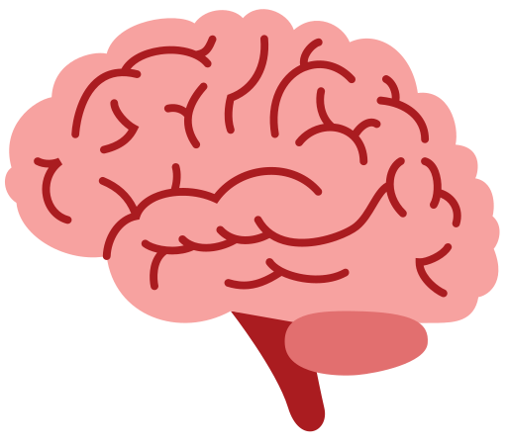


FEASIBILITY AND VIABILITY
TECHNICAL FEASIBILITY
• The AI model will track students’ performance on the basis of attendance, self-reported study
time, and questionnaire results.
• NLP model reliability will be enhanced by outsourcing data from validated educational
Psychological databases
• Collaboration with external companies will be required for enriched datasets.
• Data handling will follow strict privacy & ethical compliance standards.
Viability
• Short-term: MVP with attendance-tracking, study-time reporting, and questionnaire AI-integration
can be built in 3–4 months.
• Long-term: Expand across universities with advanced AI-driven personalization, adaptive
learning recommendations, and multilingual support.
• Sustainable through free access for students and subsidized institutional licensing.

Slide 10



FUTURE SCOPE
🤖 1. Smarter AI & Personalization
Mann Mitra will grow into a full emotional wellness ecosystem- personalized, preventive, and accessible for every student.
Add voice and multilingual chat for regional accessibility.
AI adapts tone based on user’s mood patterns for emotional support.
☁️ 2. Cloud Insights & Institutional Use
Develop a dashboard for universities to track anonymized wellness trends.
Enable secure data sync and counselor collaboration.
📱 3. Expansion & Integration
Launch mobile app version for offline journaling and meditation.
Connect with fitness bands and LMS platforms for holistic tracking.
🌍 4. Social Impact
Partner with mental health NGOs & researchers for large-scale outreach.
Promote student well-being awareness campaigns nationwide.

